Slide 1
Interactive Library System
Amritpal Jagpal and Arondeep Kakh

Slide 2
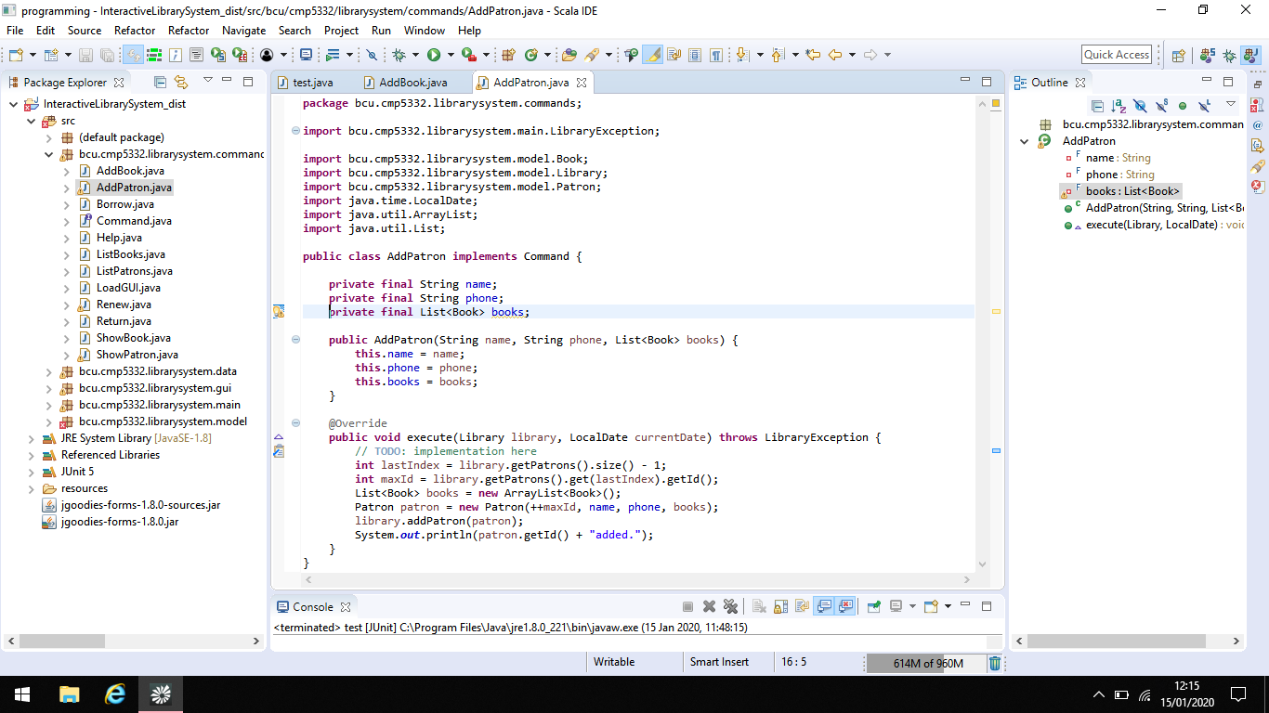
Adding a patron
S18123597
Add new Patrons (members) to the system. System should store at least the following information for each member: ID, Name, Phone Number and List of Books Borrowed.

Slide 3
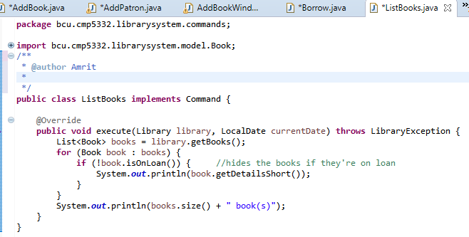
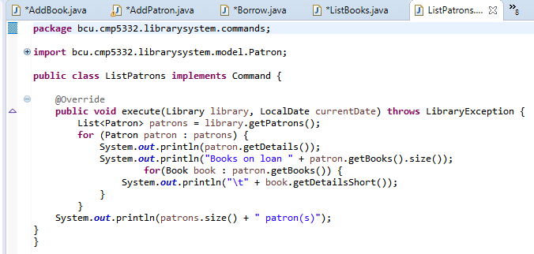
List all books and patrons
S18129116
List all Books stored in the system.
List all Patrons stored in the system.

Slide 4
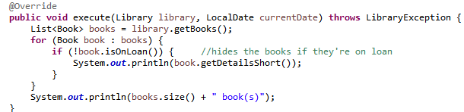
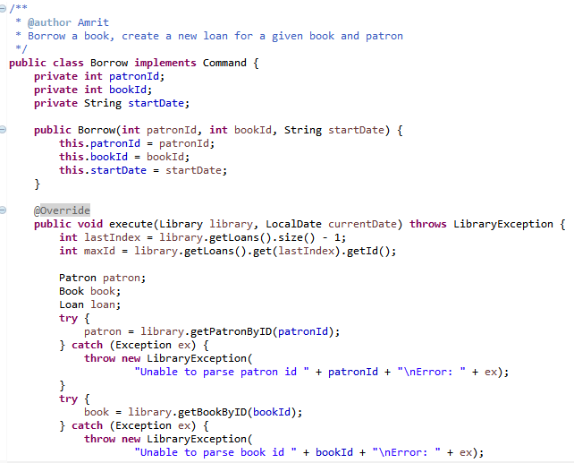
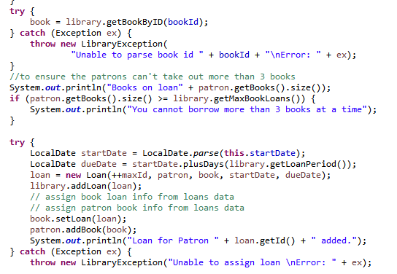
Borrowing a book
S18123597
When a book is issued to a Patron a Loan object must be created
This should be added to the Book and the book should be added to the Patron’s list of borrowed Books.

Slide 5
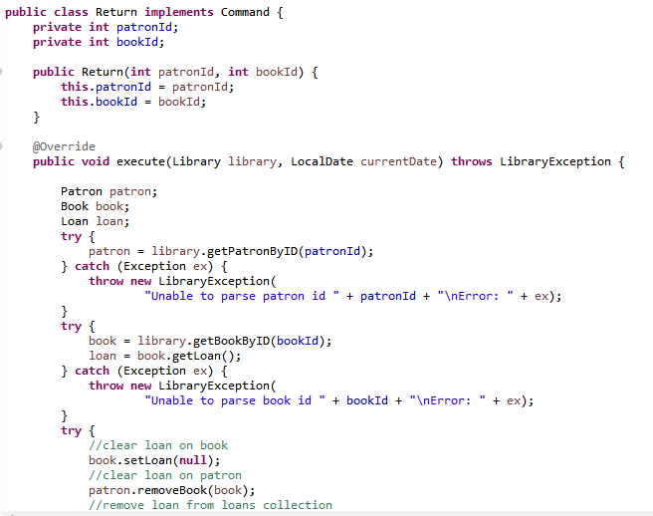
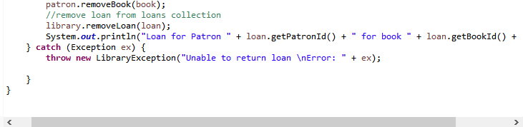
Returning a book
S18129116
When a member returns a book the status of the returned book should be updated to reflect its availability.
The book must be removed from the Patron’s list of borrowed Books.

Slide 6
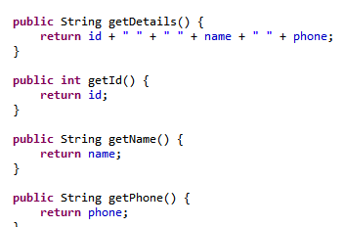
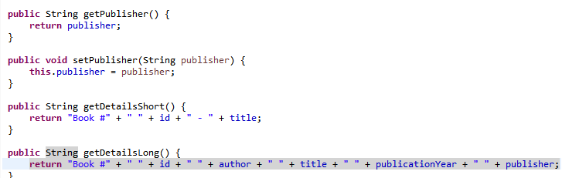
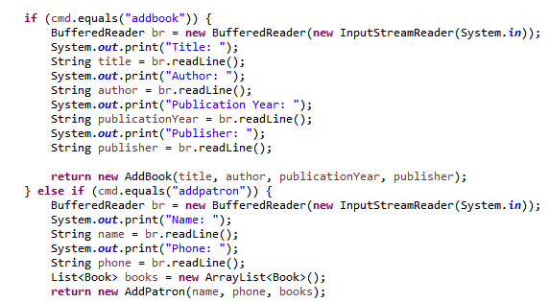
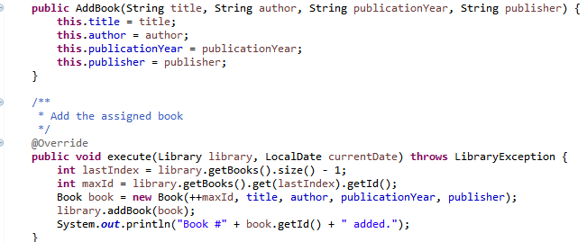
Adding Publisher and Phone
S18123597
Add a publisher property to the Book.
Getter and setter for publisher.
Add a phone property to the Patron.
Getter and setter for phone.

Slide 7
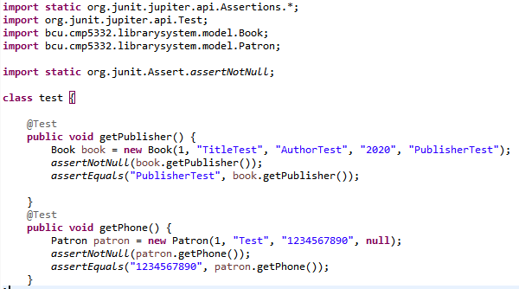
Unit Tests
S18129116
Tests to see whether the phone and publisher properties were added correctly and the appropriate output is achieved when run.

Slide 8
GUI
S18123597
The gui created has 5 functions:
Show the Patron details if a Book is on loan.
List all Patrons and their details including the number of books they have on loan.
List all Books and their details including if they’re on loan.
Show the Books details if a Patron has Books on loan.
When the “Add” submenu of the “Patrons” menu item is selected. The popup should display a form that allows the addition of a new Patron to the system.

Slide 9
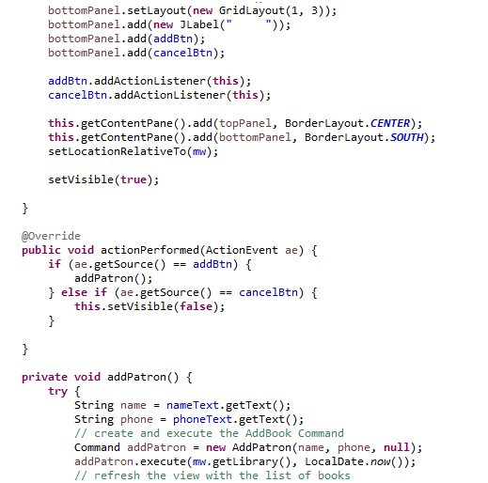
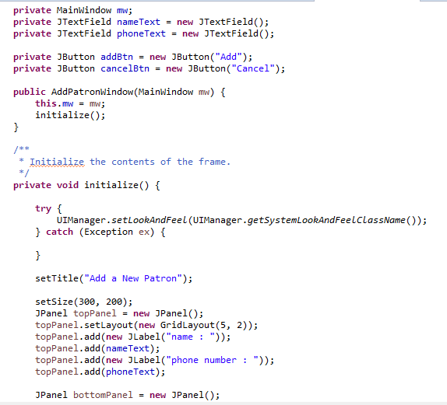
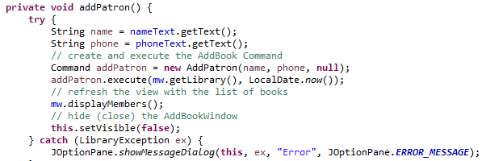
Add patron window
S18129116

Slide 10
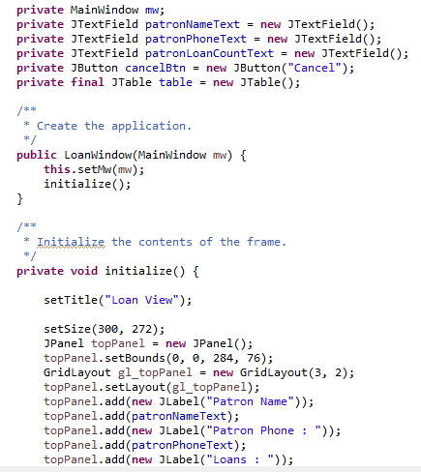
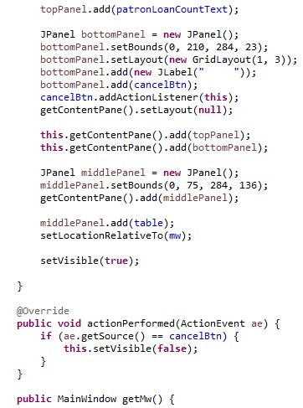
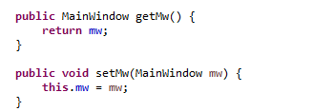
Loan window
S18123597

Slide 11
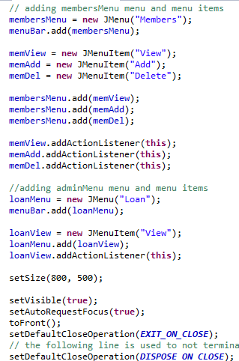
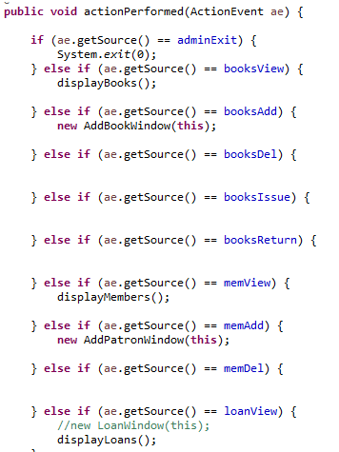
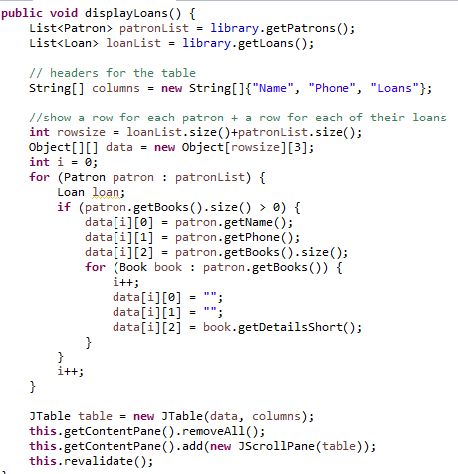
Main window
S18129116

Slide 12
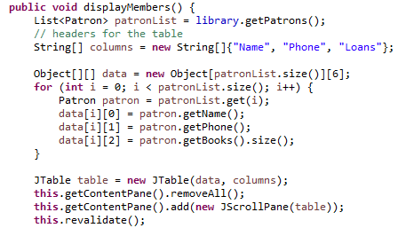
Main window extended
S18129116

Slide 13
Hiding books on loan
S18123597
Hide existing books from the system
When a book is removed, it should not appear in the books view.
Instead of completely deleting a book we have just temporarily hidden the book until returned by the patron. Using an if statement instead of Boolean, creating a statement where if the book isn’t on loan only then will it be shown in the directory.

Slide 14
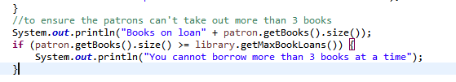
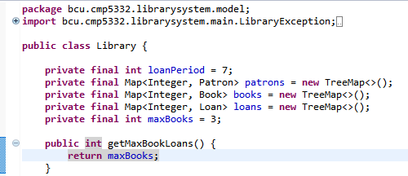
Limit on borrowed books
S18123597
Impose a limit on the maximum number of books that a patron can borrow.

